Slide 1
MINOR PROJECT
HOME AUTOMATION SYSTEM
By Group 44 -
Ayush Dhakad (181B060)
Garvit Chugh (181B090)
Rishabh Verma (181B167)
Under. Mr Gaurav Saxena Sir

Slide 2
INDEX
2
WHAT IS HOME AUTOMATION?
COMPONENTS USED
ALGORITHMS
BLOCK DIAGRAM
CIRCUIT DIAGRAM
APPLICATIONS

Slide 3
4
WHAT IS HOME AUTOMATION ?
Home Automation is the control of any or all electrical devices in our home or office, whether we are there or away. Home automation is automation of the home, housework or household activity. It’s centralized control of lighting, HVAC appliances and other system, provide improved convenience, comfort, energy efficiency and security.
A home automation system integrates electrical devices in a house with each other.Devices may be connected through a computer network to allow control by a personal computer, and may allow remote access from the internet.

Slide 4
COMPONETS USED
Following components are used in this project:
Hardware-
Arduino UNO R3, Relays Module, Wifi Module, Android Application device, Bulbs (15 - 100 watt), Holder, Bread Board, Battery with Connector , Connection /Jumper wires.
Software-
Arduino IED (windows), Smart Home(android).

Slide 5
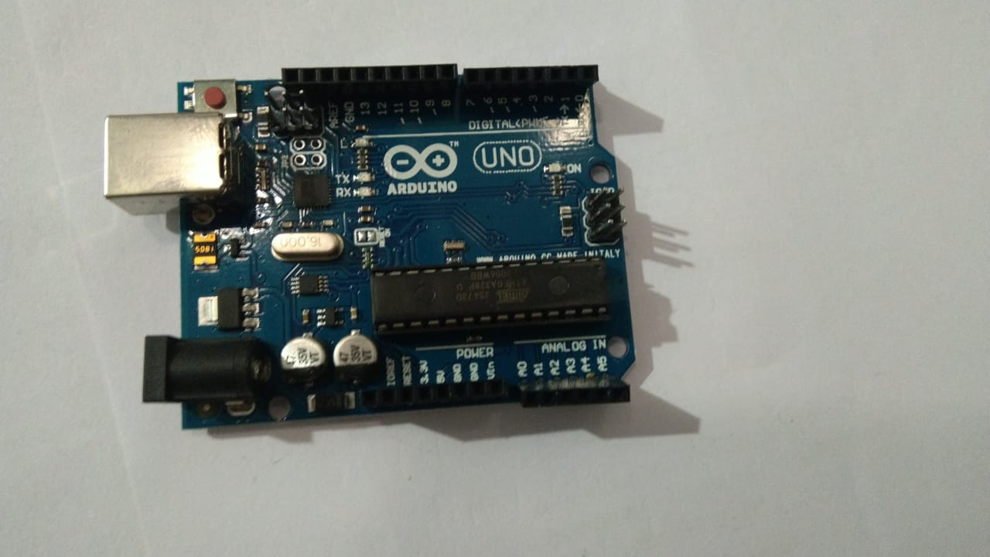
Arduino UNO R3 Chip
Arduino is an open-source, programmable microcontroller and software based on the ATMega chip. The Arduino board can be programmed using the Arduino software. The syntax is similar to C/C++ and Java.
Arduino is computer hardware and software company, project and user community that designs and manufactures microcontroller based kits for building digital devices that can sense and control objects in the physical world.

Slide 6
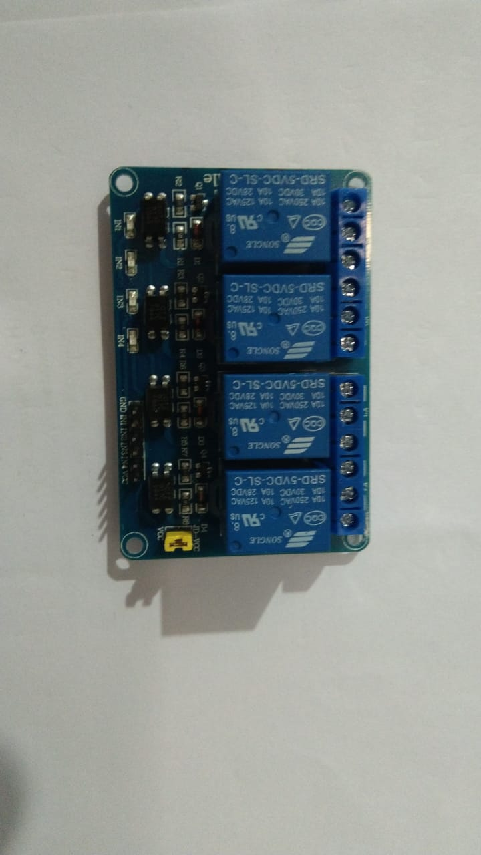
Relay Module
A relay is an electrical operated switch. Relays are used where it is necessary to control a circuit by a separate low-power signal, or where several circuits must be controlled by one signal.
Relays work on electromagnetism.The circuit which powers the coil is completely isolated from the part which switches ON/OFF, this provides electrical isolation. This is the reason we can control a relay using 5V's from an Arduino.

Slide 7
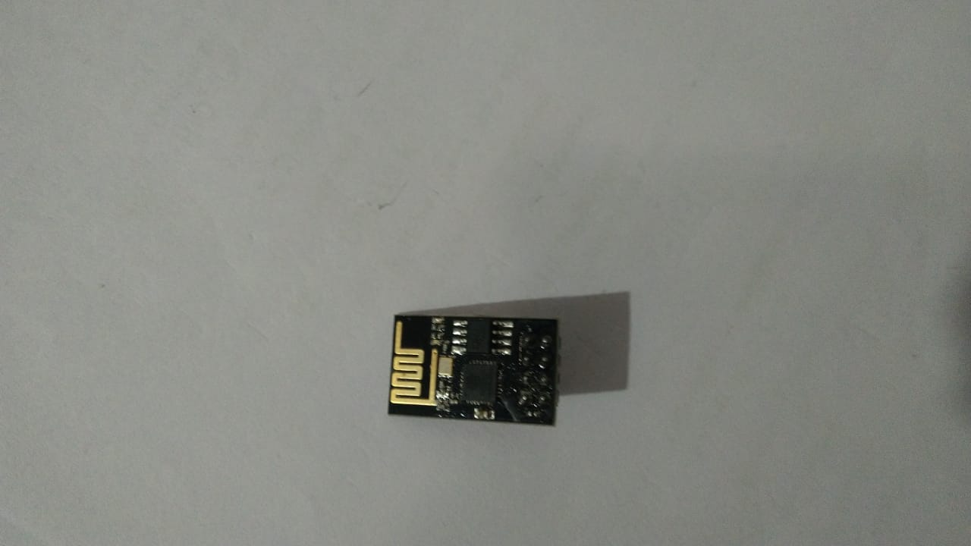
WiFi Module
The ESP8266 WiFi Module is a self contained SOC with integrated TCP/IP protocol stack that can give any microcontroller access to your WiFi network. The ESP8266 is capable of either hosting an application or offloading all WiFi networking functions from another application processor.

Slide 8
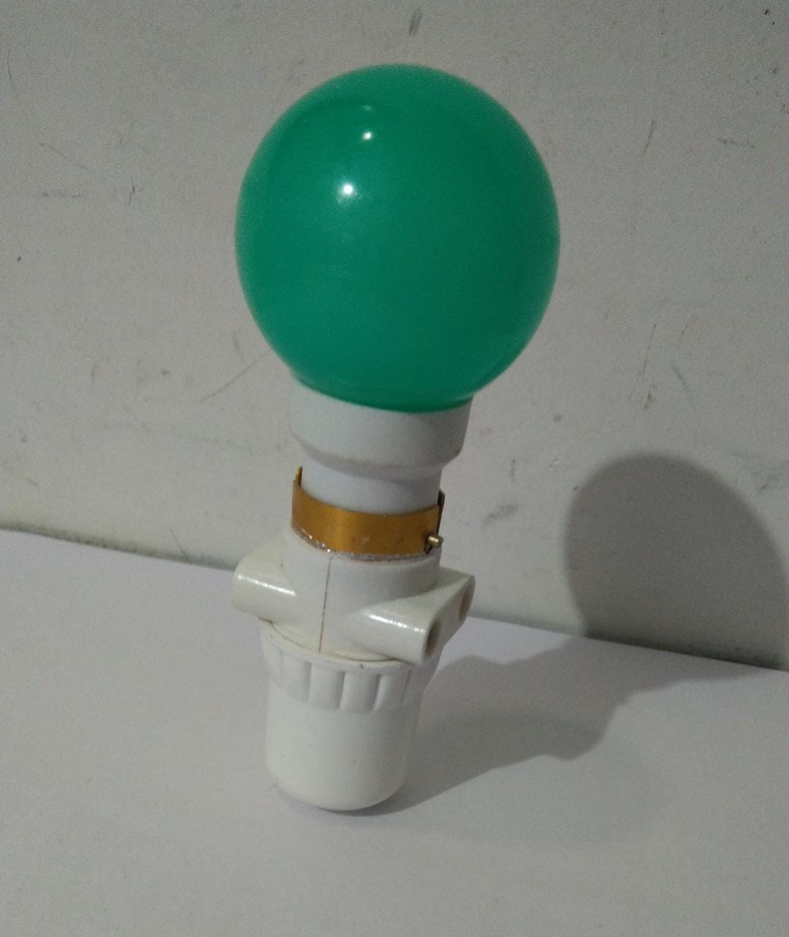
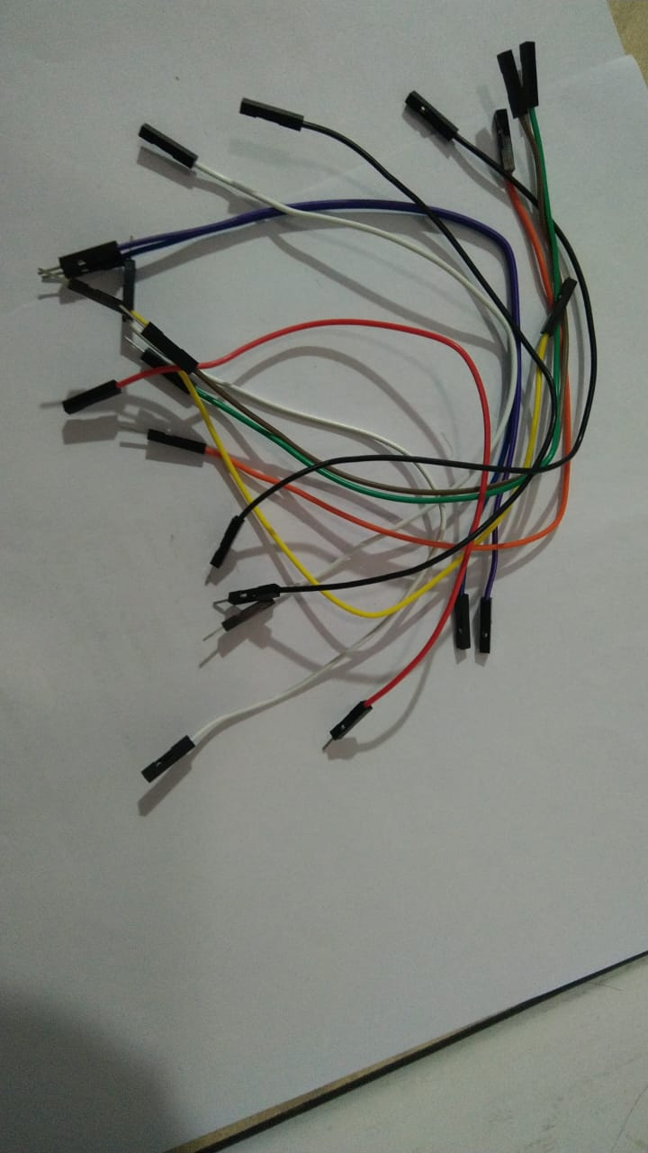
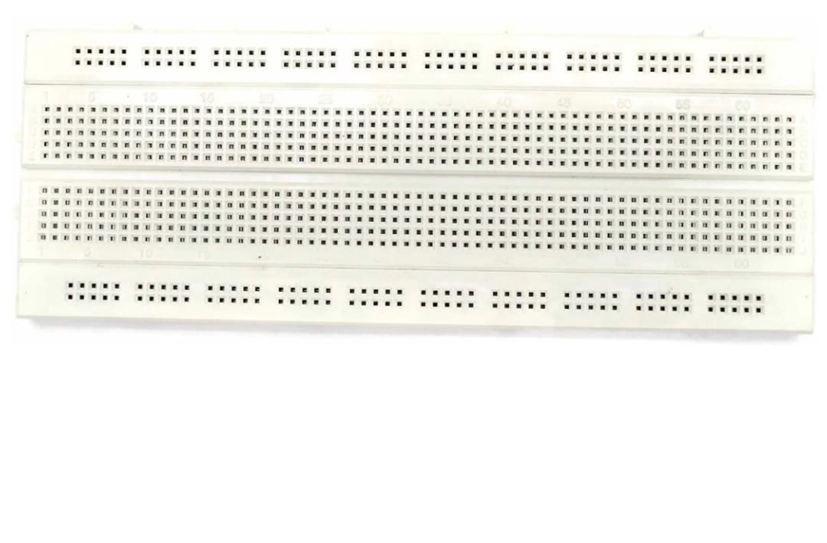
Bulbs
Bread Board

Slide 9
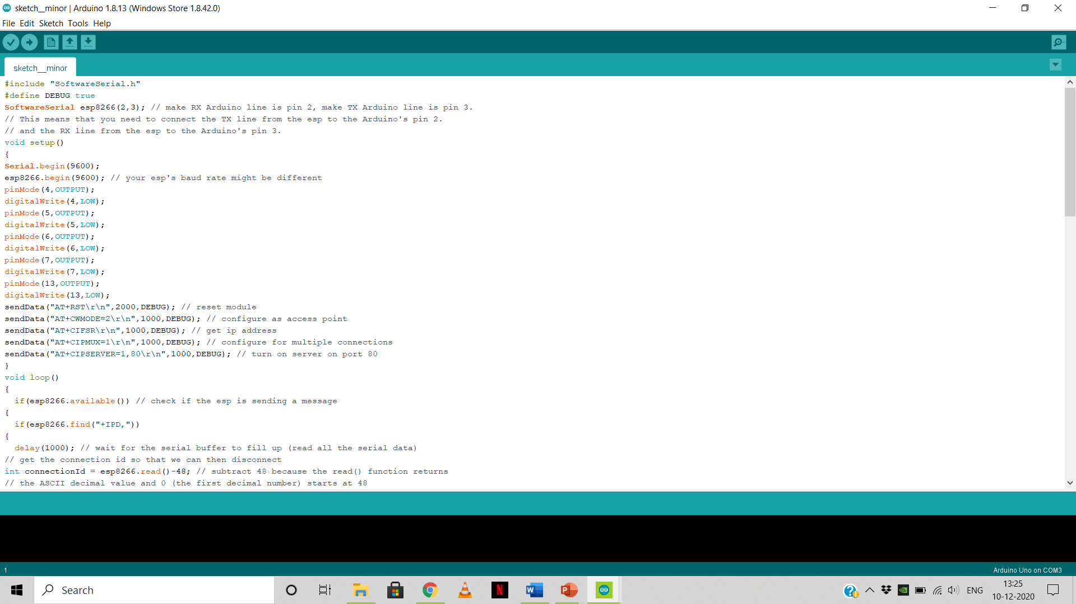
ALGORITHMS
For, this particular project we have developed a simple code. The code has been illustrated using screen shots taken from our laptop. This is for operational working of two bulbs installed in the board.

Slide 10
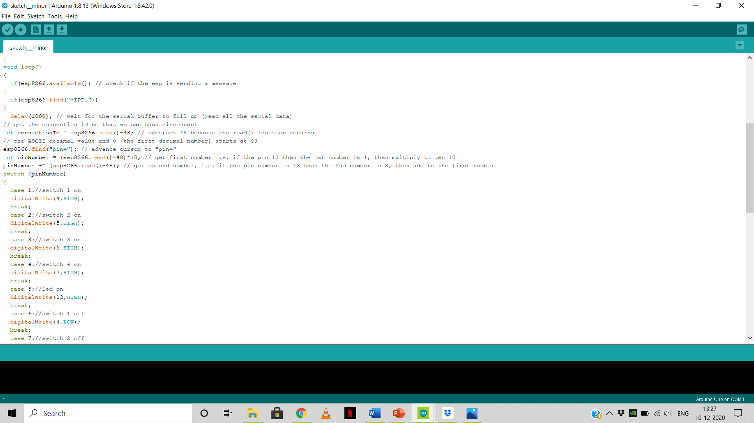

Slide 11
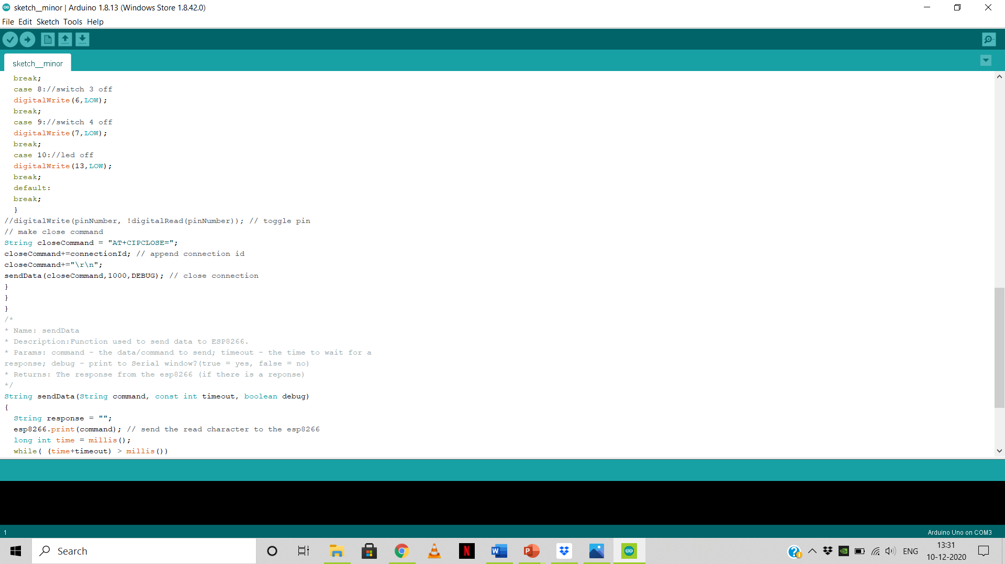

Slide 12
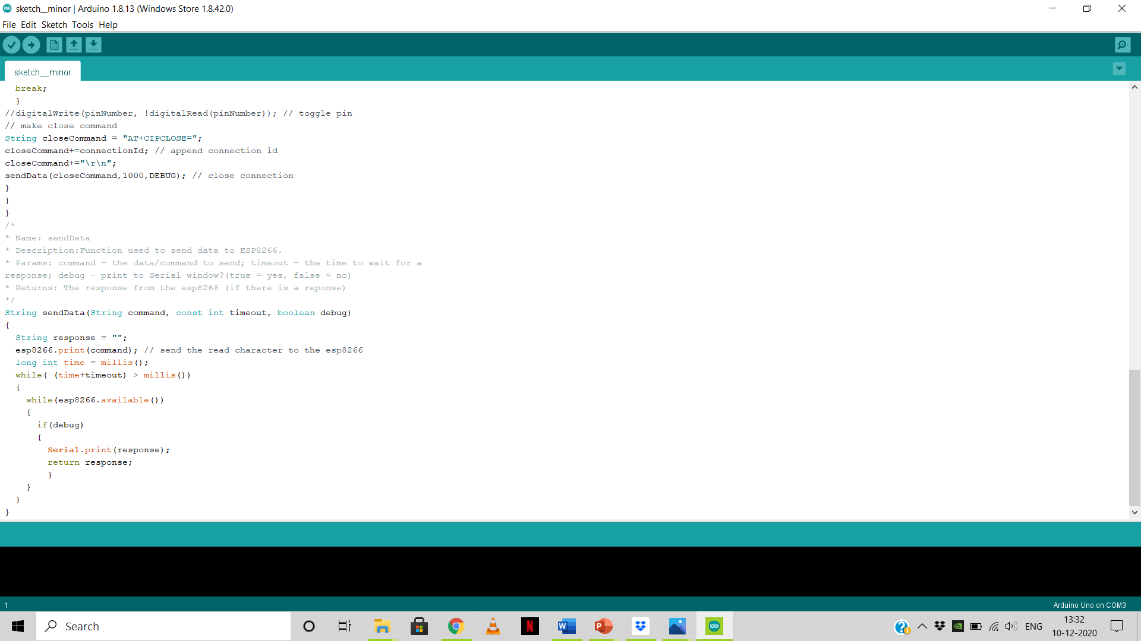

Slide 13
19
Diagram/Connections
A Wifi Module based home automation system with Arduino UNO Board and an Android application.
Remote controlled home automation system provides a simpler solution with Android application technology.

Slide 14
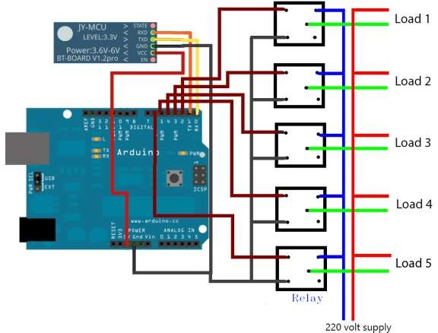
20
Circuit Diagram

Slide 15
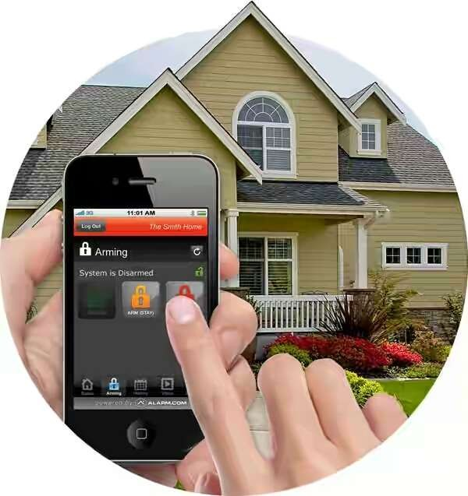
23
APPLICATIONS
Home Is Where the Smart Is ?
Lighting Control: Leaving the Dark Ages and Stepping Into the Light .
HVAC Regulation: No Longer Burned by Your Heating Bill.
Security Systems: Knock, Knock.??
Smart Appliances: What’s for Dinner?

Slide 16
THANK YOU!!!

